Slide 1

2018 Seminar on Predictive Modeling: Statistical Models using R
Jeffrey Strickland, Ph.D., CMSP, ASEP
CEO Humalytica Analytics
Proprietor Simulation Educators

Slide 2
Logistic (Logit) Regression
Logistic regression measures the relationship between a Response and one or more Predictors by using probability scores as the predicted values of the dependent response
Logistic regression can be binomial or multinomial
Yes vs No
Treatment 1 vs Treament 2
Disease A vs Disease B vs Disease C
In statistics, logistic regression, or logit regression, is a type of probabilistic statistical classification model
It is primarily used to predict a binary response from one or more predictors
It is also used for predicting the outcome of a categorical dependent variable based on one or more predictor variables
That is, it is used in estimating the parameters of a qualitative response model

Slide 3
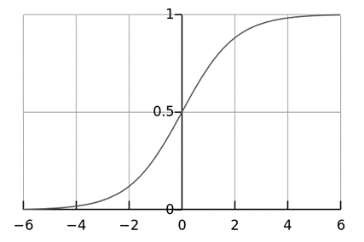
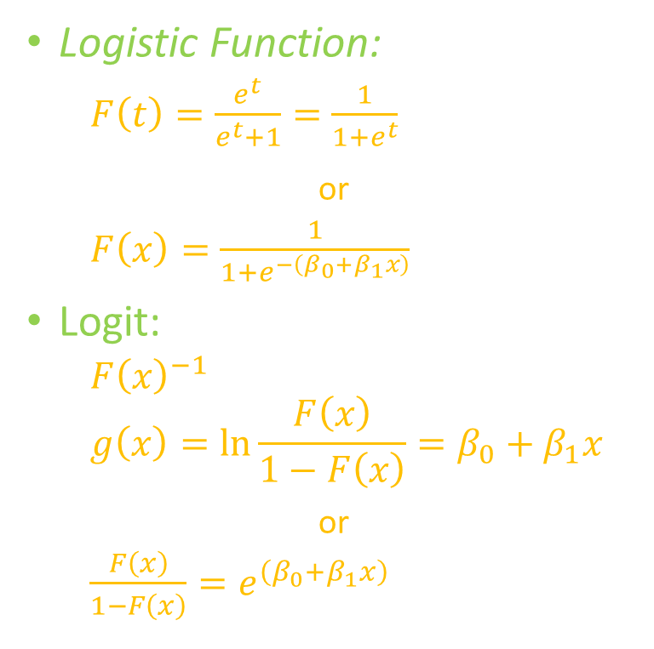
The Logistic Function
Logistic Function:
$F\left(t\right)=\frac{e^{t}}{e^{t}+1}=\frac{1}{1+e^{t}}$
or
$F\left(x\right)=\frac{1}{1+e^{−\left(β_{0}+β_{1}x\right)}}$
Logit:
$F{\left(x\right)}^{−1}$
$$g\left(x\right)=\ln{\frac{F\left(x\right)}{1−F\left(x\right)}=β_{0}+β_{1}x}$$
or
$\frac{F\left(x\right)}{1−F\left(x\right)}=e^{\left(β_{0}+β_{1}x\right)}$
Linear Function

Slide 4
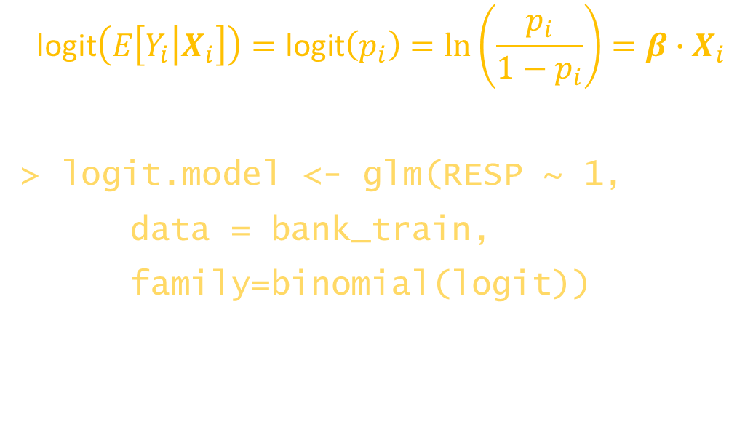
Logistic Regression as a GLM
Uses the logit link function
$$\text{logit}\left(E\left[Y_{i}\left|X_{i}\right.\right]\right)=\text{logit}\left(p_{i}\right)=\ln\left(\frac{p_{i}}{1−p_{i}}\right)=β∙X_{i}$$
> logit.model <- glm(RESP ~ 1,
data = bank_train,
family=binomial(logit))

Slide 5
Bank Marketing Campaign – Mixed Predictors
AGE (numeric)
JOB : type of job (categorical: "admin.", "unknown", "unemployed", "management", "housemaid", "entrepreneur", "student", "blue-collar", "self-employed", "retired", "technician", "services")
MARITAL : marital status (categorical: "married", "divorced", "single"; note: "divorced" means divorced or widowed)
EDUCATION (categorical: "unknown", "secondary", "primary", "tertiary")
DEFAULT: has credit in default? (binary: "yes", "no")
BALANCE: average yearly balance, in euros (numeric)
HOMEOWNER: has housing loan? (binary: "yes", "no")
LOANS: has personal loan? (binary: "yes", "no")
# related with the last contact of the current campaign:
CONTACT: contact communication type (categorical: "unknown", "telephone", "cellular")
LENGTH: length of most recent membership (numeric)
CAMPAIGN: number of contacts performed during this campaign and for this client (numeric, includes last contact)
PDAYS: number of days that passed by after the client was last contacted from a previous campaign (numeric, -1 means client was not previously contacted)
PREVIOUS: number of contacts performed before this campaign and for this client (numeric)
POUTCOME: outcome of the previous marketing campaign (categorical: "unknown", "other", "failure", "success")
Output variable (desired target):
RESP - has the client subscribed a term deposit? (binary: 1="yes", 0="no")

Slide 6
Banking Data Summary
file = "C:/’your directory path’/Banking.csv”
read.csv(file) -> bank
summary(bank)
job marital education age
blue-collar:9732 divorced: 5207 primary : 6851 Min. :18.00
management :9458 married :27214 secondary:23202 1st Qu.:33.00
technician :7597 single :12790 tertiary :13301 Median :39.00
admin. :5171 unknown : 1857 Mean :40.94
services :4154 3rd Qu.:48.00
retired :2264 Max. :95.00
(Other) :6835
balance homeowner loans default
Min. : -8019 Min. :0.0000 Min. :0.0000 Min. :0.00000
1st Qu.: 72 1st Qu.:0.0000 1st Qu.:0.0000 1st Qu.:0.00000
Median : 448 Median :1.0000 Median :0.0000 Median :0.00000
Mean : 1362 Mean :0.5558 Mean :0.1602 Mean :0.01803
3rd Qu.: 1428 3rd Qu.:1.0000 3rd Qu.:0.0000 3rd Qu.:0.00000
Max. :102127 Max. :1.0000 Max. :1.0000 Max. :1.00000

Slide 7
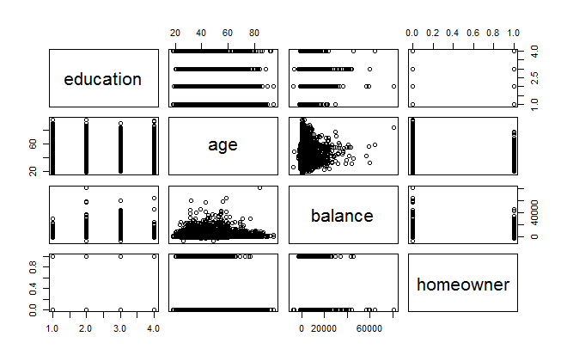
Plot Bank_Train Data
bank_train<-bank[2:22606,]
bank_test<-bank[22607:45211,]

Slide 8
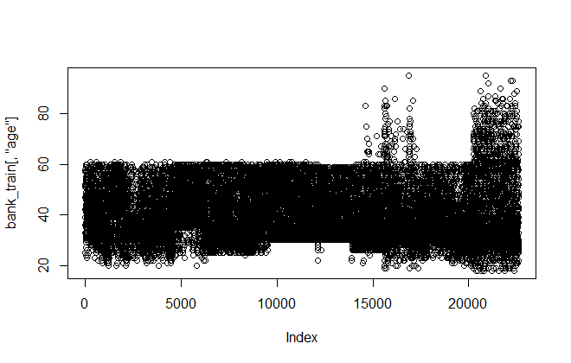
Plot of Age
plot(bank_train[,"age"])

Slide 9
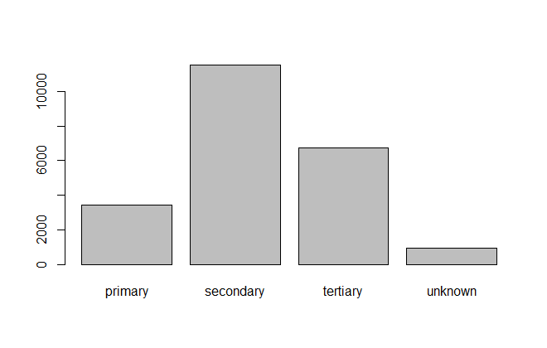
Plot of Education
plot(bank_train[,"education"])

Slide 10
Multicolinearity
Multicollinearity occurs when independent variables in a regression model are correlated
It is a problem because independent variables should be independent.
If the degree of correlation between variables is high enough, it can cause problems when you fit the model and interpret the results.
Two basic types of problems:
Sensitivity
Coefficients become very sensitive to small changes in the model
Coefficient estimates can vary widely based on which other independent variables are in the model
Precision
Multicollinearity reduces the precision of the estimate coefficients, which weakens the statistical power of your regression model.
You might not be able to trust the p-values to identify independent variables that are statistically significant.

Slide 11
Correlaton Matrix
cor(bank_train[,4:11])
age balance homeowner loans default contact length campaign
age 1.000000000 0.09680490 -0.190975835 -0.012896902 -0.018938025 0.070856843 -0.000967989 0.01367817
balance 0.096804902 1.00000000 -0.076668653 -0.085288420 -0.070715325 0.052495004 0.019825556 -0.02157692
homeowner -0.190975835 -0.07666865 1.000000000 0.043970215 -0.001664111 -0.223396107 0.004308323 -0.02670261
loans -0.012896902 -0.08528842 0.043970215 1.000000000 0.076876099 0.004873391 -0.009488590 0.02200102
default -0.018938025 -0.07071532 -0.001664111 0.076876099 1.000000000 -0.031707956 -0.014317479 0.02333830
contact 0.070856843 0.05249500 -0.223396107 0.004873391 -0.031707956 1.000000000 0.007215661 0.01000163
length -0.000967989 0.01982556 0.004308323 -0.009488590 -0.014317479 0.007215661 1.000000000 -0.07260177
campaign 0.013678168 -0.02157692 -0.026702607 0.022001022 0.023338301 0.010001632 -0.072601771 1.00000000

Slide 12
Bank Logistic Model
bank.model <- glm( RESP ~ job + marital + education + age + balance + homeowner + loans + default + contact + length + campaign + pdays + previous + outcome, data = bank_train, family=binomial(logit))
summary(bank.model)
Call:
glm(formula = RESP ~ job + marital + education + age + balance +
homeowner + loans + default + contact + length + campaign +
pdays + previous + poutcome, family = binomial(logit), data = bank_train)
Deviance Residuals:
Min 1Q Median 3Q Max
-5.7298 -0.4430 -0.2871 -0.1692 3.7263
---
(Dispersion parameter for binomial family taken to be 1)
Null deviance: 16285 on 22604 degrees of freedom
Residual deviance: 12054 on 22577 degrees of freedom
AIC: 12110
Number of Fisher Scoring iterations: 6

Slide 13

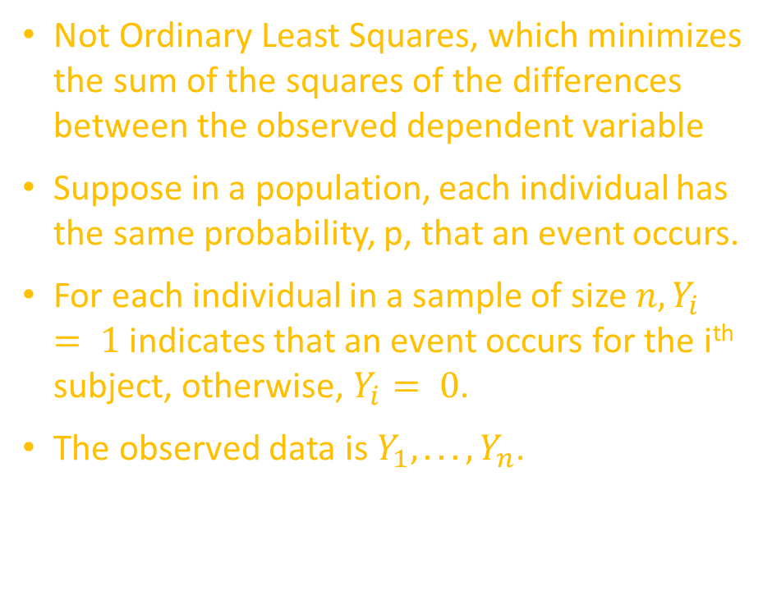
Maximum Likelihood Estimation
Not Ordinary Least Squares, which minimizes the sum of the squares of the differences between the observed dependent variable
Suppose in a population, each individual has the same probability, p, that an event occurs.
For each individual in a sample of size $n, Y_{i}= 1$ indicates that an event occurs for the i^{th} subject, otherwise, $Y_{i}= 0$.
The observed data is $Y_{1}, . . . , Y_{n}$.
The joint probability of the data (the likelihood) is given by
$$L = \prod_{i=1}^{n}{p^{2}Y_{i\left(1 − p\right)1}−Y_{i}= }$$
$p^{\sum_{\begin{aligned} \\ i=1\end{aligned}}^{n}{Y_{i}}}{(1−p}^{n−\sum_{i=1}^{n}{Y_{i}}}$)
For estimation, we will work with the log-likelihood
$$ℓ=\log\left(L\right)= {\sum_{i=1}^{n}{Y_{i}}}_{i}\log\left(p\right)+\left(n − \sum_{i=1}^{n}{Y_{i}}\right)\log\left(1 − p\right)$$
The maximum likelihood estimate (MLE) of p is that value that maximizes $ℓ$ (equivalent to maximizing $L$).

Slide 14
Four Models in One
Fitted Model
Null Model
Saturated Model
Independence Model
The fitted model is the researcher's structural model, always more frugal than the saturated model and almost always fitting better than the independence model with which it is compared using goodness of fit measures
In the null model the covariances in the covariance matrix among the latent variables are all assumed to be zero, and assumes that the factors of a model construct are unrelated
The saturated model is the trivial but fully explanatory model in which there are as many parameter estimates as degrees of freedom
The independence model is one which assumes all relationships among measured variables are 0, and is refferred to as the Uncorrelated variables model.

Slide 15
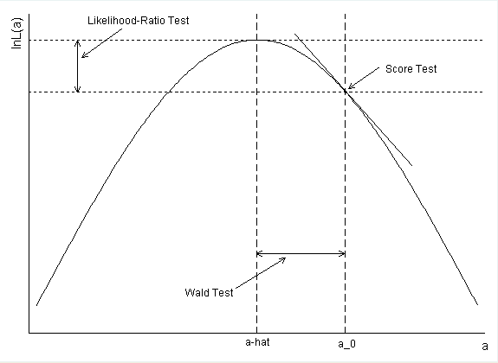
Various Goodness of Fit Tests
Likelihood ratio tests look at the ratio of the likelihoods (or difference in log likelihoods) at its maximum and at the null. This is often considered the best test.
The Wald test assumes that the likelihood is normally distributed, and on that basis, uses the degree of curvature to estimate the standard error. Then, the parameter estimate divided by the SE yields a z-score. This holds under large N, but isn't quite true with smaller Ns. It is hard to say when your N is large enough for this property to hold, so this test can be slightly risky.
The score test (Chi-Squared Test) is based on the slope of the likelihood at the null value. This is typically less powerful, but there are times when the full likelihood cannot be computed and so this is a nice fallback option.
As N becomes large, the three test p-values will converge

Slide 16
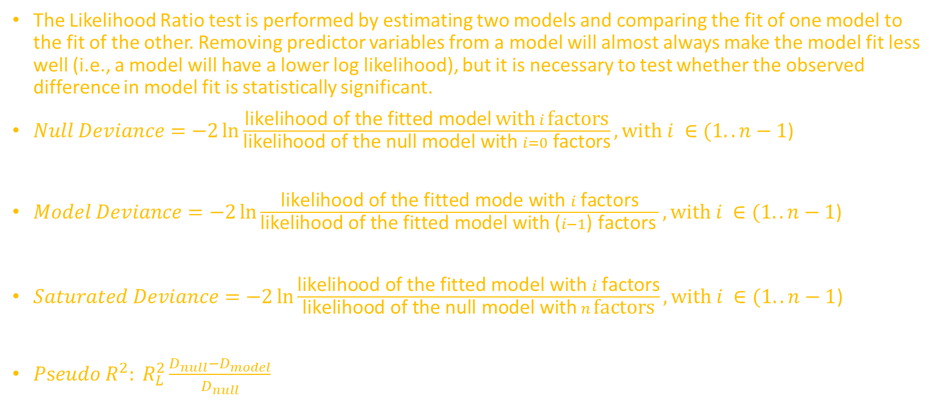
Likelihood-Ratio & Related Measures
The Likelihood Ratio test is performed by estimating two models and comparing the fit of one model to the fit of the other. Removing predictor variables from a model will almost always make the model fit less well (i.e., a model will have a lower log likelihood), but it is necessary to test whether the observed difference in model fit is statistically significant.
$Null Deviance=−2\ln{\frac{\text{likelihood} \text{of} \text{the} \text{fitted} \text{model} \text{with} i \text{factors}}{\text{likelihood} \text{of} \text{the} \text{null} \text{model} \text{with} i=0 \text{factors}}}, with i ∈(1..n−1\text{)}$
$Model Deviance=−2\ln{\frac{\text{likelihood} \text{of} \text{the} \text{fitted} \text{mode} \text{with} i \text{factors}}{\text{likelihood} \text{of} \text{the} \text{fitted} \text{model} \text{with}\text{ (}i−1\text{) }\text{factors} }, with i ∈(1..n−1\text{)} }$
$Saturated Deviance=−2\ln{\frac{\text{likelihood} \text{of} \text{the} \text{fitted} \text{model} \text{with} i \text{factors}}{\text{likelihood} \text{of} \text{the} \text{null} \text{model} \text{with} n \text{factors}}}, with i ∈(1..n−1$)
$Pseudo R^{2}: R_{L}^{2}\frac{D_{null}−D_{model}}{D_{null}}$

Slide 17

Null Deviance
$D_{null}=−2\ln{\frac{\text{likelihood} \text{of} \text{the} \text{fitted} \text{model}}{\text{likelihood} \text{of} \text{the} \text{null} \text{model}}}$
> summary(bank.model)
Null deviance: 16285 on 22604 degrees of freedom
Residual deviance: 12054 on 22577 degrees of freedom
> -2*log(12054/16285)
0.6016588
> -2*log(bank.model$deviance/bank.model$null.deviance)
0.6016588

Slide 18

Model Deviance – 1st Iteration
$D_{model}=−2\ln{\frac{\text{likelihood} \text{of} \text{the} \text{fitted} \text{model}}{\text{likelihood} \text{of} \text{the} \text{fitted} \text{model} −\text{1 }\text{paramenter}}}$
> summary(bank.model)
Null deviance: 16285 on 22604 degrees of freedom
Residual deviance: 12054 on 22577 degrees of freedom
> -2*log(12054/12237)
0.0301393
> -2*log(bank.model$deviance/bank.model2$null.deviance)
0.03013519

Slide 19

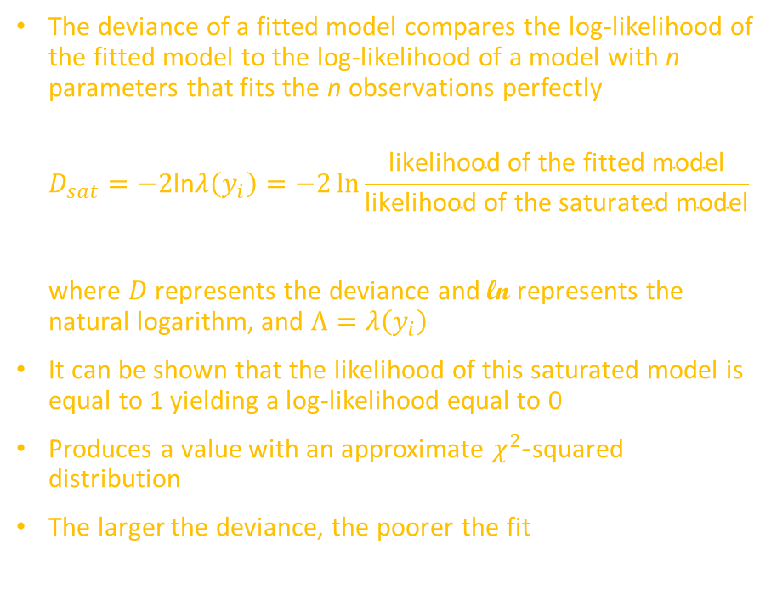
Saturated Deviance
The deviance of a fitted model compares the log-likelihood of the fitted model to the log-likelihood of a model with n parameters that fits the n observations perfectly
$$D_{sat}=−2\text{ln}λ\left(y_{i}\right)=−2\ln{\frac{\text{likelihood} \text{of} \text{the} \text{fitted} \text{model}}{\text{likelihood} \text{of} \text{the} \text{saturated} \text{model}}}$$
where $D$ represents the deviance and $\text{ln}$ represents the natural logarithm, and $Λ=λ\left(y_{i}\right)$
It can be shown that the likelihood of this saturated model is equal to 1 yielding a log-likelihood equal to 0
Produces a value with an approximate $χ^{2}$-squared distribution
The larger the deviance, the poorer the fit
In the Bank example:
$$logit\left(π_{i}\right)= β_{0} + β_{1}job_{i} has deviance=384.25$$
$$logit\left(π_{i}\right)= β_{0}+ β_{1}homeowner_{i}has deviance=293.73$$
$$logit\left(π_{i}\right)= β_{0}+ β_{1}loans_{i}has deviance=90.53$$
$$logit\left(π_{i}\right)= β_{0}+ β_{1}default_{i}has deviance=14.26$$
Df Deviance Resid. Df Resid. Dev Pr(>Chi)
NULL 22604 16285
job 11 384.25 22593 15901 < 2.2e-16
homeowner 1 257.98 22585 15480 < 2.2e-16
loans 1 79.48 22584 15400 < 2.2e-16
default 1 11.95 22583 15388 0.0005475

Slide 20
Likelihood-Ratio Tests
The “standard deviance” is found as -2 times the log-Likelihood of the fitted model
c(bank.model$deviance, -2*logLik(bank.model))
[1] 12054.23 12054.23
The “null deviance” is -2 times the log-Likilihood for the same model with only a constant term
c(bank.model$null.dev, -2*logLik(update(bank.model, formula = .~ 1)))
[1] 16285.01 16285.01

Slide 21
Likelihood Ratio Test
> library(lmtest)
> lrtest(bank.model)
Likelihood ratio test
Model 1: RESP ~ job + marital + education + age + balance + homeowner + loans + default + contact + length + campaign + pdays + previous + poutcome
Model 2: RESP ~ 1
#Df LogLik Df Chisq Pr(>Chisq)
1 28 -6027.1
2 1 -8142.5 -27 4230.8 < 2.2e-16 ***
---
Signif. codes: 0 ‘***’ 0.001 ‘**’ 0.01 ‘*’ 0.05 ‘.’ 0.1 ‘ ’ 1

Slide 22
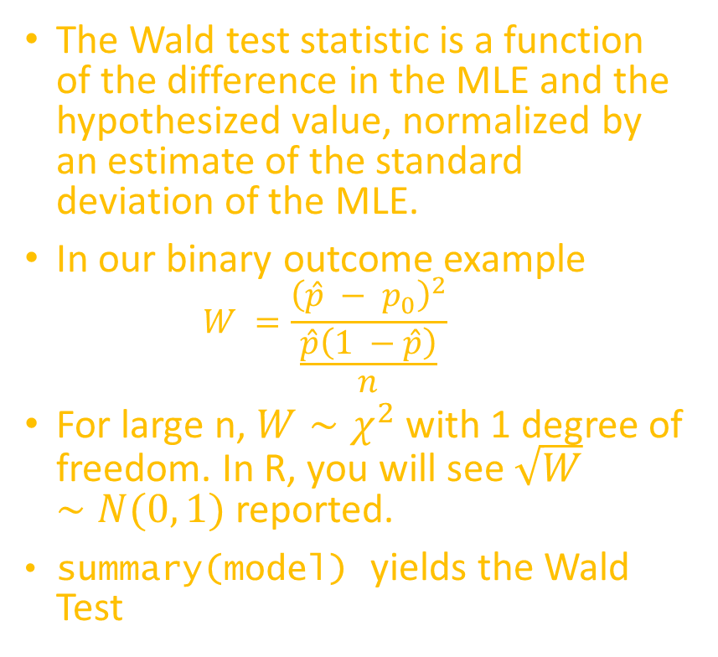
Wald Test
The Wald test statistic is a function of the difference in the MLE and the hypothesized value, normalized by an estimate of the standard deviation of the MLE.
In our binary outcome example
$$W =\frac{{\left(\hat{p} − p_{0}\right)}^{2}}{\frac{\hat{p}\left(1 −\hat{p}\right)}{n}}$$
For large n, $W∼χ^{2}$ with 1 degree of freedom. In R, you will see $\sqrt{W}∼N(0, 1)$ reported.
summary(model) yields the Wald Test
Df Deviance Resid. Df Resid. Dev Pr(>Chi)
NULL 22604 16285
job 11 384.25 22593 15901 < 2.2e-16 ***
marital 2 58.35 22591 15842 2.133e-13 ***
education 3 45.56 22588 15797 7.037e-10 ***
age 1 28.80 22587 15768 8.006e-08 ***
balance 1 30.60 22586 15737 3.176e-08 ***
homeowner 1 257.98 22585 15480 < 2.2e-16 ***
loans 1 79.48 22584 15400 < 2.2e-16 ***
default 1 11.95 22583 15388 0.0005475 ***
contact 1 281.31 22582 15107 < 2.2e-16 ***
length 1 2699.45 22581 12407 < 2.2e-16 ***
campaign 1 152.38 22580 12255 < 2.2e-16 ***
pdays 1 172.81 22579 12082 < 2.2e-16 ***
previous 1 26.36 22578 12056 2.839e-07 ***

Slide 23

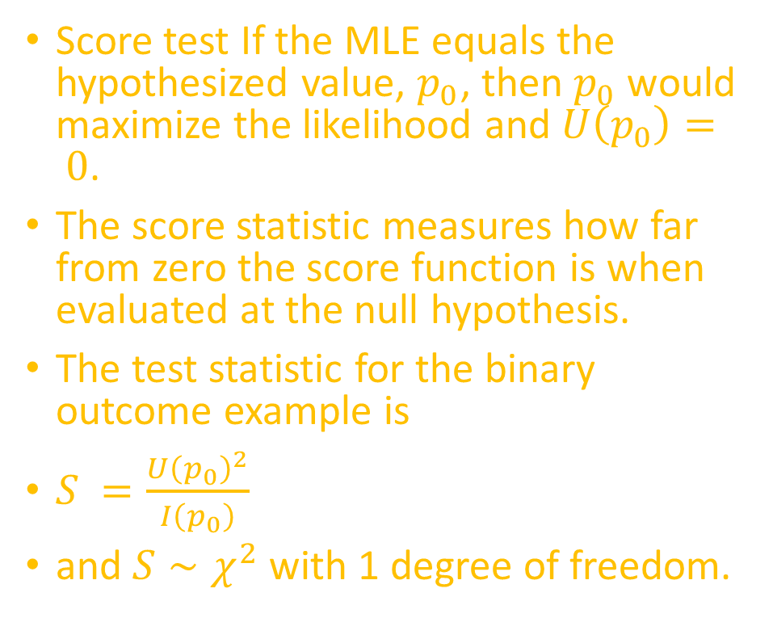
Score Test: ${χ }^{2}$ Test
Score test If the MLE equals the hypothesized value, $p_{0}$, then $p_{0}$ would maximize the likelihood and $U\left(p_{0}\right)= 0$.
The score statistic measures how far from zero the score function is when evaluated at the null hypothesis.
The test statistic for the binary outcome example is
$S =\frac{U{\left(p_{0}\right)}^{2}}{I\left(p_{0}\right)}$
and $S∼χ^{2}$ with 1 degree of freedom.
E=matrix(0,nrow=10,ncol=2)
O=matrix(0,nrow=10,ncol=2)
for(j in 1:10){
E[j,2]=sum(fi1[fi1c==j])
E[j,1]=sum((1-fi1)[fi1c==j])
O[j,2]=sum(bank_train$RESP[fi1c==j])
O[j,1]=sum((1-bank_train$RESP)[fi1c==j]) }
sum((O-E^2/E)) → 7.460699e-13
1-pchisq(sum((O-E^2/E)),8) → 1

Slide 24


${χ }^{2}$ Goodness of Fit Test
$logit\left(π_{i}\right)= β_{0}+ β_{1}job + β_{2}marital + β_{3}education + β_{4}age + β_{5}homehowner + β_{6}loans + β_{7}default + β_{8}contact + β_{9}length + β_{10}campaign + β_{11}pdays + β_{12}previous.$
Order and group the fitted values
fi1<-fitted(bank.model)
fi1c<-cut(fi1,br=c(0,quantile(fi1,p=seq(.1,.9,.1)),1))
table(fi1c)
fi1c=cut(fi1,br=c(0,quantile(fi1,p=seq(.1,.9,.1)),1),labels=F)
table(fi1c)
fi1c
(0,0.0116] (0.0116,0.0198] (0.0198,0.0299] (0.0299,0.0422] (0.0422,0.0582]
2261 2260 2261 2260 2261
(0.0582,0.0798] (0.0798,0.112] (0.112,0.167] (0.167,0.288] (0.288,1]
2260 2260 2261 2260 2261
fi1c
1 2 3 4 5 6 7 8 9 10
2261 2260 2261 2260 2261 2260 2260 2261 2260 2261

Slide 25
${χ }^{2}$ Goodness of Fit Test
[1] 7.460699e-13
[1] 1
E=matrix(0,nrow=10,ncol=2)
O=matrix(0,nrow=10,ncol=2)
for(j in 1:10){
E[j,2]=sum(fi1[fi1c==j])
E[j,1]=sum((1-fi1)[fi1c==j])
O[j,2]=sum(bank_train$RESP[fi1c==j])
O[j,1]=sum((1-bank_train$RESP)[fi1c==j]) }
sum((O-E^2/E))
1-pchisq(sum((O-E^2/E)),8)

Slide 26
Coefficients
Coefficients: Estimate Std. Error z value Pr(>|z|)
educationsecondary 1.854e-01 8.648e-02 2.144 0.032066 *
educationtertiary 5.069e-01 9.935e-02 5.103 3.35e-07 ***
educationunknown 3.767e-01 1.339e-01 2.813 0.004910 **
age 3.668e-03 2.874e-03 1.276 0.201797
balance 1.823e-05 7.002e-06 2.604 0.009219 **
homeowner -9.216e-01 5.433e-02 -16.965 < 2e-16 ***
loans -6.933e-01 8.178e-02 -8.477 < 2e-16 ***
default -4.651e-01 2.582e-01 -1.801 0.071664 .
contact 4.495e-01 3.321e-02 13.533 < 2e-16 ***
length 3.920e-03 8.556e-05 45.810 < 2e-16 ***
campaign -1.357e-01 1.399e-02 -9.699 < 2e-16 ***
pdays 2.073e-03 3.104e-04 6.678 2.43e-11 ***
previous 5.695e-02 1.222e-02 4.660 3.16e-06 ***
poutcome -5.852e-02 4.782e-02 -1.224 0.221044
Coefficients: Estimate Std. Error z value Pr(>|z|)
(Intercept) -3.595e+00 2.207e-01 -16.287 < 2e-16 ***
jobblue-collar -5.219e-01 9.882e-02 -5.281 1.28e-07 ***
jobentrepreneur -6.292e-01 1.763e-01 -3.569 0.000358 ***
jobhousemaid -4.910e-01 1.762e-01 -2.787 0.005323 **
jobmanagement -2.786e-01 9.710e-02 -2.869 0.004122 **
jobretired 3.871e-01 1.261e-01 3.070 0.002143 **
jobself-employed -4.514e-01 1.471e-01 -3.069 0.002145 **
jobservices -2.009e-01 1.096e-01 -1.834 0.066715 .
jobstudent 5.087e-01 1.426e-01 3.569 0.000359 ***
jobtechnician -2.024e-01 9.017e-02 -2.244 0.024803 *
jobunemployed -2.118e-01 1.484e-01 -1.427 0.153698
jobunknown -8.614e-01 3.649e-01 -2.361 0.018249 *
maritalmarried -7.842e-02 7.826e-02 -1.002 0.316353
maritalsingle 2.684e-01 8.870e-02 3.026 0.002481 **

Slide 27
95% Two-Sided Confidence Interval
Confidence intervals are calculated by profiling the likelihood ratio (which is a better approach than multiplying the SE by 1.96)
> confint(bank.model)
2.5 % 97.5 %
(Intercept) -4.029284e+00 -3.163920e+00
jobblue-collar -7.157301e-01 -3.282610e-01
jobentrepreneur -9.834001e-01 -2.914083e-01
jobhousemaid -8.444295e-01 -1.529580e-01
jobmanagement -4.683290e-01 -8.762104e-02
jobretired 1.395856e-01 6.340041e-01
jobself-employed -7.437570e-01 -1.668597e-01
jobservices -4.168544e-01 1.282886e-02
jobstudent 2.276397e-01 7.866995e-01
jobtechnician -3.787776e-01 -2.520265e-02
jobunemployed -5.070094e-01 7.530807e-02
jobunknown -1.631431e+00 -1.903762e-01
2.5 % 97.5 %
maritalmarried -2.304653e-01 7.639652e-02
maritalsingle 9.553294e-02 4.433218e-01
educationsecondary 1.701616e-02 3.560896e-01
educationtertiary 3.131049e-01 7.026032e-01
educationunknown 1.121545e-01 6.373805e-01
age -1.972446e-03 9.292638e-03
balance 4.276588e-06 3.174683e-05
homeowner -1.028494e+00 -8.155136e-01
loans -8.559031e-01 -5.352111e-01
default -1.002989e+00 1.364481e-02
contact 3.849173e-01 5.151368e-01
length 3.753023e-03 4.088445e-03

Slide 28
Exponentiated Coefficients
> exp(bank.model$coefficients)
(Intercept) jobblue-collar jobentrepreneur jobhousemaid
0.02745411 0.59340229 0.53300724 0.61202350
jobmanagement jobretired jobself-employed jobservices
0.75687343 1.47269483 0.63673139 0.81799537
jobstudent jobtechnician jobunemployed jobunknown
1.66319461 0.81677775 0.80916033 0.42256947
maritalmarried maritalsingle educationsecondary educationtertiary
0.92457992 1.30784779 1.20366656 1.66016442
educationunknown age balance homeowner
1.45748075 1.00367464 1.00001823 0.39786357
loans default contact length
0.49993184 0.62809734 1.56752315 1.00392725
campaign pdays previous poutcome
0.87313251 1.00207501 1.05860588 0.94316319

Slide 29
95% Two-Sided Confidence Interval
> exp(confint(bank.model)0
2.5 % 97.5 %
(Intercept) 0.01778705 0.04225978
jobblue-collar 0.48883509 0.72017502
jobentrepreneur 0.37403718 0.74721052
jobhousemaid 0.42980250 0.85816573
jobmanagement 0.62604751 0.91610798
jobretired 1.14979724 1.88514371
jobself-employed 0.47532474 0.84631831
jobservices 0.65911687 1.01291150
jobstudent 1.25563279 2.19613613
jobtechnician 0.68469791 0.97511228
jobunemployed 0.60229410 1.07821626
jobunknown 0.19564935 0.82664813
2.5 % 97.5 %
maritalmarried 0.79416399 1.07939049
maritalsingle 1.10024507 1.55787359
educationsecondary 1.01716176 1.42773553
educationtertiary 1.36766500 2.01900181
educationunknown 1.11868565 1.89151958
age 0.99802950 1.00933595
balance 1.00000428 1.00003175
homeowner 0.35754512 0.44241206
loans 0.42489928 0.58554567
default 0.36678164 1.01373833
contact 1.46949280 1.67386741
length 1.00376007 1.00409681

Slide 30
Analysis of variance for individual terms
Anova(bank.model, type="II", test="Wald")
Signif. codes:
0 ‘***’ 0.001 ‘**’ 0.01 ‘*’ 0.05 ‘.’ 0.1 ‘ ’ 1
Analysis of Deviance Table (Type II tests)
Response: RESP
Df Chisq Pr(>Chisq)
job 11 124.4277 < 2.2e-16 ***
marital 2 32.9576 6.972e-08 ***
education 3 33.2757 2.817e-07 ***
age 1 1.6293 0.201797
balance 1 6.7798 0.009219 **
homeowner 1 287.8107 < 2.2e-16 ***
loans 1 71.8677 < 2.2e-16 ***
default 1 3.2445 0.071664 .
contact 1 183.1552 < 2.2e-16 ***
length 1 2098.5216 < 2.2e-16 ***
campaign 1 94.0668 < 2.2e-16 ***
pdays 1 44.5896 2.430e-11 ***
previous 1 21.7164 3.161e-06 ***
poutcome 1 1.4976 0.221044

Slide 31

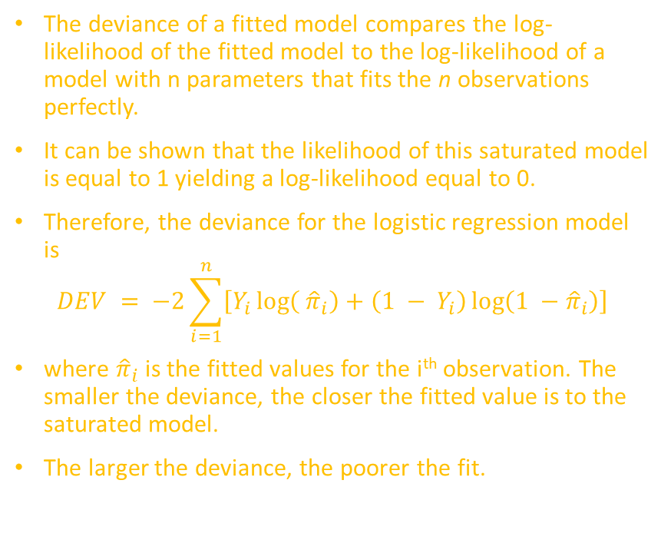
Deviance
The deviance of a fitted model compares the log-likelihood of the fitted model to the log-likelihood of a model with n parameters that fits the n observations perfectly.
It can be shown that the likelihood of this saturated model is equal to 1 yielding a log-likelihood equal to 0.
Therefore, the deviance for the logistic regression model is
$$DEV = −2\sum_{i=1}^{n}{\left[Y_{i}\log\left( {\hat{π}}_{i}\right)+\left(1 − Y_{i}\right)\log\left(1 −{\hat{π}}_{i}\right)\right]}$$
where ${\hat{π}}_{i}$ is the fitted values for the i^{th} observation. The smaller the deviance, the closer the fitted value is to the saturated model.
The larger the deviance, the poorer the fit.
In the Bank example:
$$logit\left(π_{i}\right)= β_{0} + β_{1}job_{i} has deviance=384.25$$
$$logit\left(π_{i}\right)= β_{0}+ β_{1}homeowner_{i}has deviance=293.73$$
$$logit\left(π_{i}\right)= β_{0}+ β_{1}loans_{i}has deviance=90.53$$
$$logit\left(π_{i}\right)= β_{0}+ β_{1}default_{i}has deviance=14.26$$
Df Deviance Resid. Df Resid. Dev Pr(>Chi)
NULL 22604 16285
job 11 384.25 22593 15901 < 2.2e-16
homeowner 1 257.98 22585 15480 < 2.2e-16
loans 1 79.48 22584 15400 < 2.2e-16
default 1 11.95 22583 15388 0.0005475

Slide 32
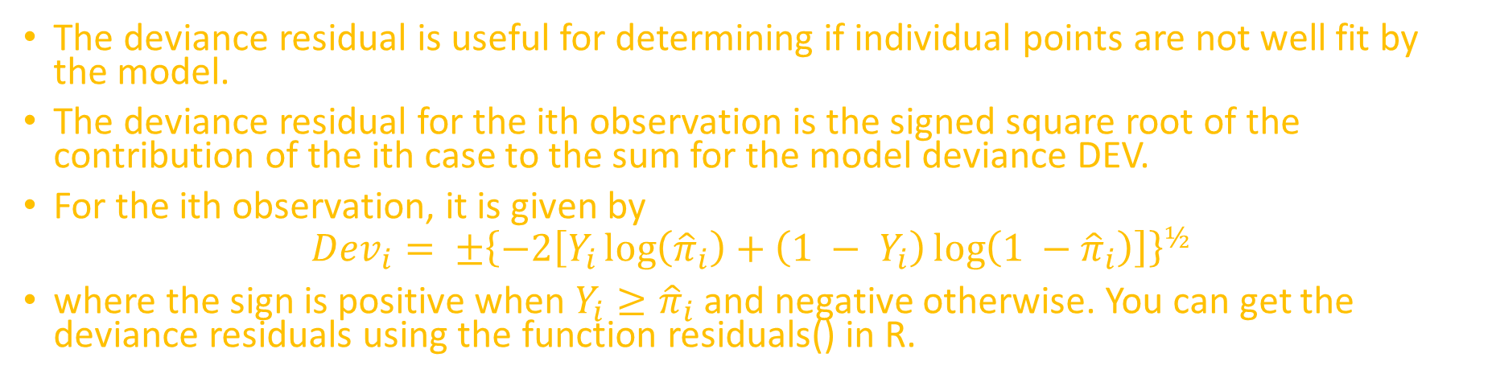
Deviance residual
The deviance residual is useful for determining if individual points are not well fit by the model.
The deviance residual for the ith observation is the signed square root of the contribution of the ith case to the sum for the model deviance DEV.
For the ith observation, it is given by
$$Dev_{i}= ±{\left\{−2\left[Y_{i}\log\left({\hat{π}}_{i}\right)+\left(1 − Y_{i}\right)\log\left(1 −{\hat{π}}_{i}\right)\right]\right\}}^{½}$$
where the sign is positive when $Y_{i}≥{\hat{π}}_{i}$ and negative otherwise. You can get the deviance residuals using the function residuals() in R.
In the Bank example,
Residual deviance: 12054 on 22577 degrees of freedom

Slide 33
Overall p-value for model
# update here produces null model for comparison
anova(model,
update(model, ~1),
test="Chisq")
Analysis of Deviance Table
Model 1: RESP ~ job + marital + education + age + balance + homeowner + loans + default + contact + length + campaign + pdays + previous + poutcome
Model 2: RESP ~ 1
Resid. Df Resid. Dev Df Deviance Pr(>Chi)
1 22577 12054
2 22604 16285 -27 -4230.8 < 2.2e-16 ***
---
Signif. codes: 0 ‘***’ 0.001 ‘**’ 0.01 ‘*’ 0.05 ‘.’ 0.1 ‘ ’ 1

Slide 34
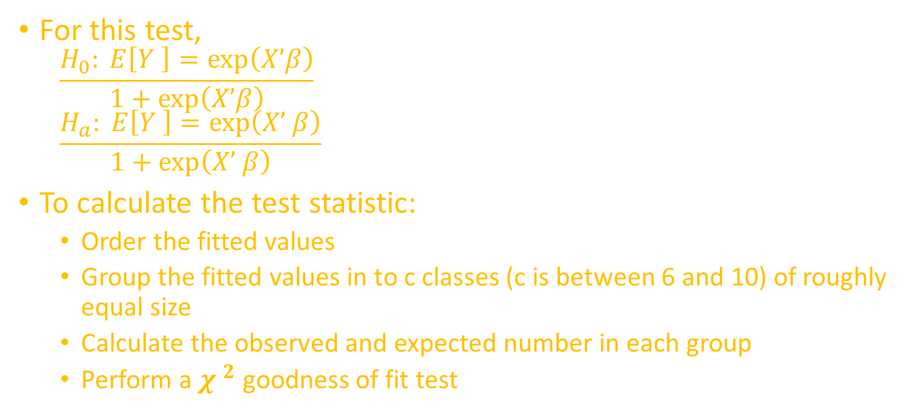
Hosmer-Lemeshow goodness of fit test
For this test,
$$\frac{H_{0}: E\left[Y \right]=\exp\left(X’β\right)}{1+\exp\left(X’β\right)}$$
$$\frac{H_{a}: E\left[Y \right]=\exp\left(X’ β\right)}{1+\exp\left(X’ β\right)}$$
To calculate the test statistic:
Order the fitted values
Group the fitted values in to c classes (c is between 6 and 10) of roughly equal size
Calculate the observed and expected number in each group
Perform a ${χ }^{2}$ goodness of fit test

Slide 35
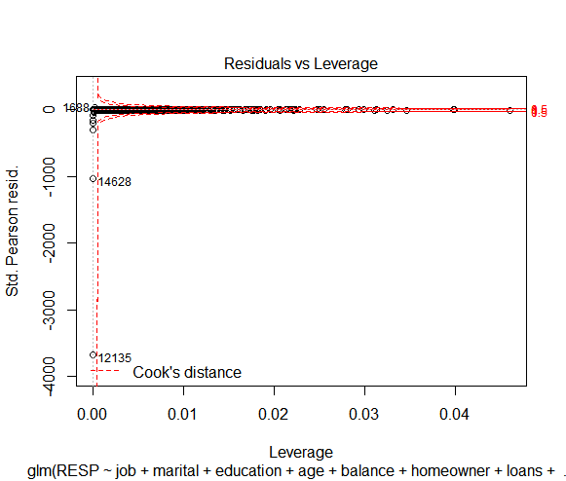
Influential observations
As in linear regression, we can use DFFITS and DFBETAS to identify influential observations
require(graphics)
infglm.SR <- influence.measures(
bank.model)
infglm.any<-
which(apply(infglm.SR$is.inf,
1, any))
summary(infglm.any)
# which obs 'are' influential?
summary(infglm.SR)
plot(bank.model, which = 5)

Slide 36
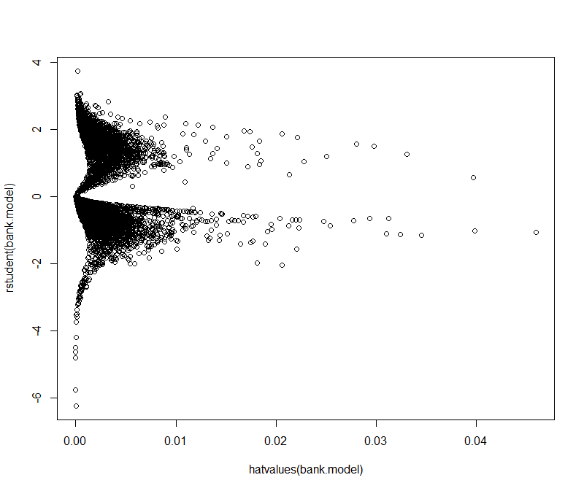
Influencial Observations
require(graphics)
plot(rstudent(bank.model) ~
hatvalues(bank.model))

Slide 37
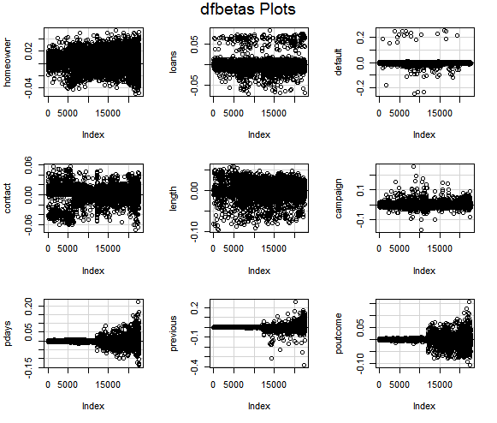
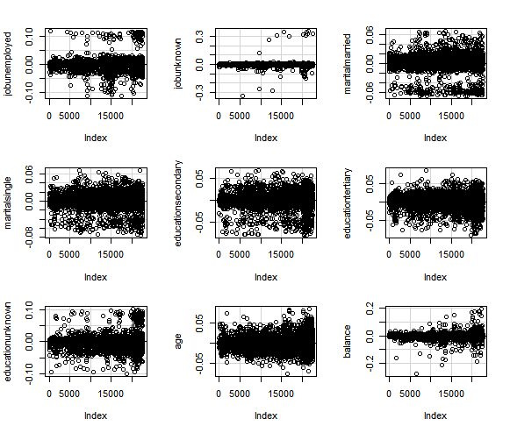
dfbetasPlots(bank.model)

Slide 38
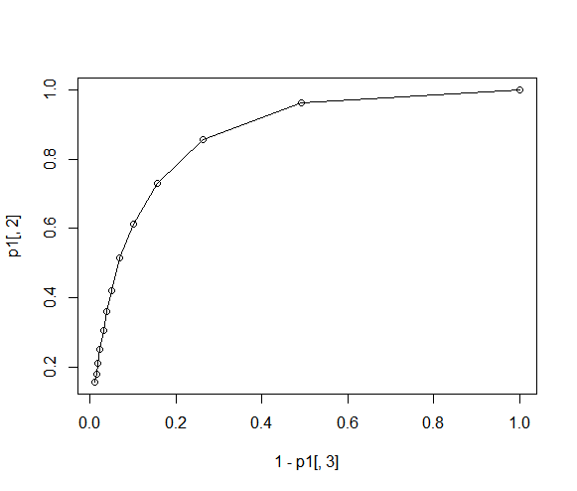
Quantifying predictive ability
We can plot the receiver operating characteristic (ROC) curve. This curve is a plot of 1-specificity against sensitivity
p1=matrix(0,nrow=13,ncol=3)
i=1
for(p in seq(min(fitted(bank.model)),.95,.05)){
t1=table(fitted(bank.model)>p,bank_train$RESP)
p1[i,]=c(p,t1[2,2])/sum(t1[,2]),(t1[1,1])/sum(t1[,1]))
i=i+1
}
plot(1-p1[,3],p1[,2],type="o")

Slide 39
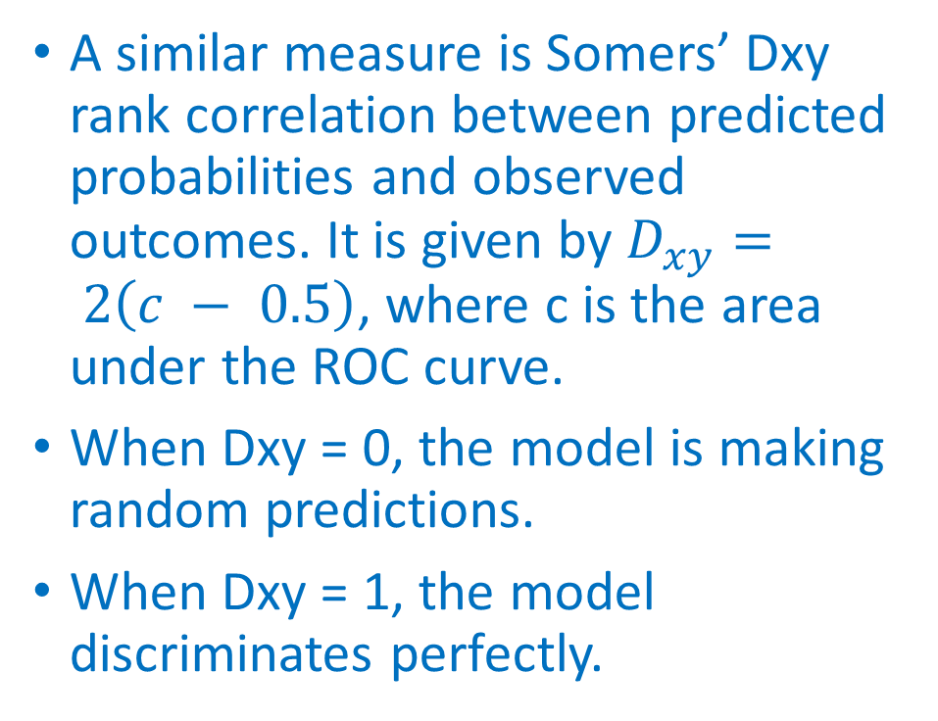
ROC Interpretation
The area under the ROC curve can give us insight into the predictive ability of the model. If it is equal to 0.5, the model can be thought of as predicting at random (an ROC curve with slope = 1).
Values close to 1 indicate that the model has good predictive ability.
A similar measure is Somers’ Dxy rank correlation between predicted probabilities and observed outcomes. It is given by $D_{xy}= 2\left(c − 0.5\right)$, where c is the area under the ROC curve.
When Dxy = 0, the model is making random predictions.
When Dxy = 1, the model discriminates perfectly.

Slide 40
Bank Model 2
bank.model2 <- glm( RESP ~ job + marital + homeowner + loans + default + contact + length , data = bank_train, family=binomial(logit))
anova(bank.model2, test="Chisq")
Analysis of Deviance Table
Model: binomial, link: logit
Response: RESP
Terms added sequentially (first to last)
Df Deviance Resid. Df Resid. Dev Pr(>Chi)
NULL 22604 16285
job 11 384.25 22593 15901 < 2.2e-16 ***
marital 2 58.35 22591 15842 2.133e-13 ***
homeowner 1 293.73 22590 15549 < 2.2e-16 ***
loans 1 90.53 22589 15458 < 2.2e-16 ***
default 1 14.26 22588 15444 0.000159 ***
contact 1 293.79 22587 15150 < 2.2e-16 ***
length 1 2698.22 22586 12452 < 2.2e-16 ***
---
Signif. codes: 0 ‘***’ 0.001 ‘**’ 0.01 ‘*’ 0.05 ‘.’ 0.1 ‘ ’ 1

Slide 41
Create a Distribution Table for RESP
pval<-1 - pchisq(5053.5, df=18)
pval
cbind( Freq=table(bank_train["RESP"]), Cumul=cumsum(table(bank_train["RESP"])), relative=prop.table(table(bank_train["RESP"])))
[1] 0
Freq Cumul relative
0 19968 19968 0.8833444
1 2637 22605 0.1166556

Slide 42
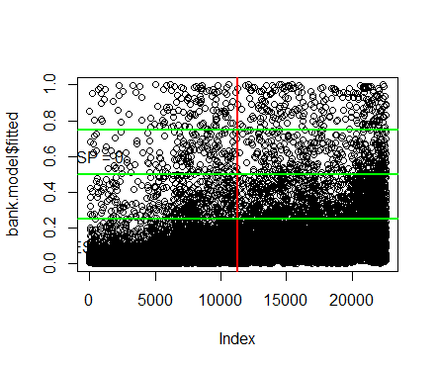
Mapping the fitted data
plot(bank.model$fitted)
abline(v=11303,col="red",lwd=2)
abline(h=.25,col="green",lwd=2)
abline(h=.5,col="green",lwd=2)
abline(h=.75,col="green",lwd=2)
text(15,.6,"RESP = 0")
text(400,.1,"RESP = 1")

Slide 43
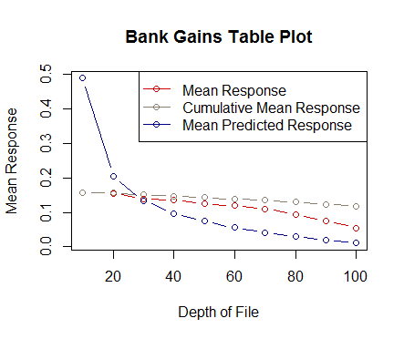
Plot the Gains
The graph is constructed with the cumulative number of cases (in descending order of probability) on the x-axis and the cumulative number of true positives on the y-axis as shown below.
True positives are those observations from the important class (here class 1) that are classified correctly.
plot(with(subset(bank,bank_train==0), bank.gains), main="Bank Gains Table Plot")

Slide 44
Create Gains Table
require(gains)
bank.pred<-predict(bank.model2, newdata = bank_test, type="response")
Depth Cume Cume Pct Optimal Optimal Mean
of Cume Mean Mean of Total Lift Cume Lift Cume Model
File N N Resp Resp Resp Index Lift Index Lift Score
-----------------------------------------------------------------------------------------
10 2261 2261 0.16 0.16 13.5% 135 135 445 445 0.49
20 2260 4521 0.16 0.16 26.8% 133 134 185 315 0.21
30 2260 6781 0.14 0.15 38.7% 119 129 117 249 0.13
40 2262 9043 0.14 0.15 50.4% 116 126 81 207 0.10
50 2260 11303 0.13 0.14 61.1% 107 122 59 177 0.07
60 2260 13563 0.12 0.14 71.3% 102 119 43 155 0.06
70 2260 15823 0.11 0.13 80.7% 94 115 31 137 0.04
80 2261 18084 0.09 0.13 88.8% 81 111 21 123 0.03
90 2260 20344 0.08 0.12 95.3% 65 106 13 110 0.02
100 2261 22605 0.05 0.12 100.0% 47 100 6 100 0.01

Slide 45
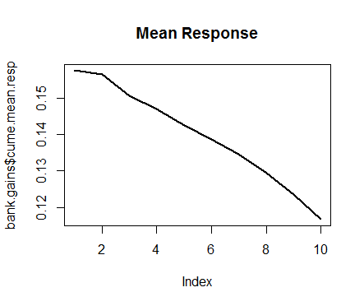
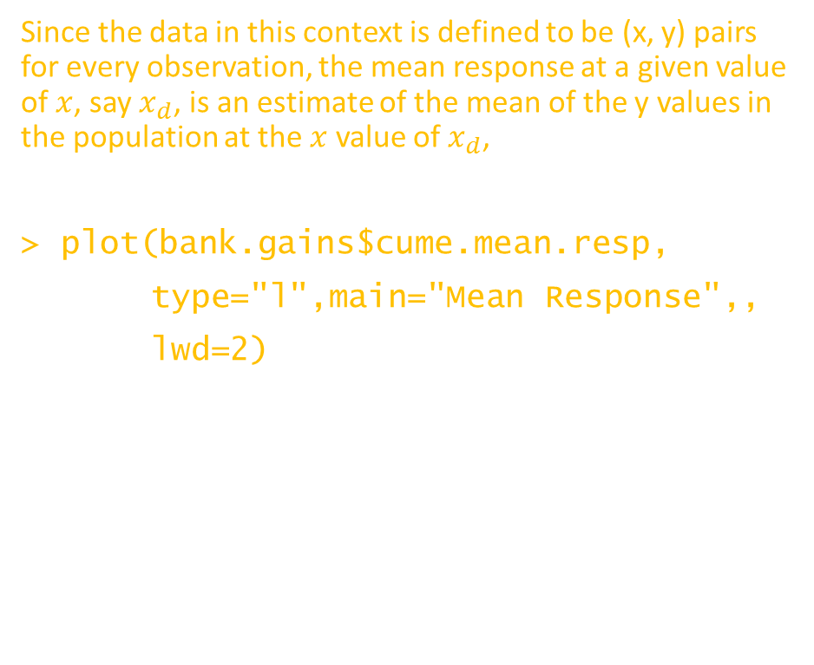
Plot Mean Response
Since the data in this context is defined to be (x, y) pairs for every observation, the mean response at a given value of $x$, say $x_{d}$, is an estimate of the mean of the y values in the population at the $x$ value of $x_{d}$,
> plot(bank.gains$cume.mean.resp,
type="l",main="Mean Response",,
lwd=2)

Slide 46
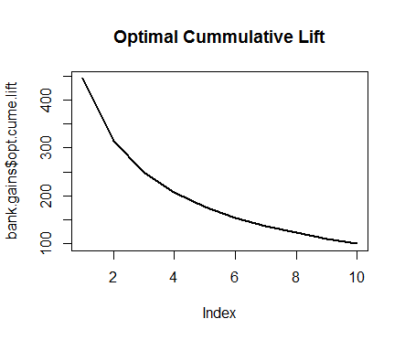
Plot Optimal Cummulative Lift
lift is a measure of the performance of a targeting model (association rule) at predicting or classifying cases as having an enhanced response (with respect to the population as a whole), measured against a random choice targeting model
> plot(bank.gains$opt.cume.lift,
type="l",
main="Optimal Cummulative Lift“
,,lwd=2)

Slide 47
www.humalytica.com
http://www.amazon.com/Jeffrey-Strickland/e/B00IQ69QZK/
http://www.lulu.com/spotlight/strickland_jeffrey

